Slide 1
Saving Lives with Simulation: Modelling Deployed Medical Support
123456124
56743712371
BAE Systems proprietary. Copyright ©2024 BAE Systems. All rights reserved. BAE Systems is a registered trademark of BAE Systems plc.

Slide 2

The Question:
How can we better understand & predict deployed medical requirements?
Defence Medical Services commissioned Techmodal to:
Generate evidence to better understand medical requirements against an operational scenario
Generate evidence to better understand how current medical facilities would fare in that scenario
Thereby inform strategic medical capability development decisions.
BAE Systems proprietary. Copyright ©2024 BAE Systems. All rights reserved. BAE Systems is a registered trademark of BAE Systems plc.

Slide 3
What are ‘Medical Requirements’?
Do we know the numbers and types of casualties we may have to treat?
Of those casualties, who will require emergency treatment, surgery, intensive care or other treatments?
To provide those treatments:
What facilities need to be deployed and where?
What transport is required to move patients efficiently?
What equipment do we need to have?
How should medical facilities be staffed?
BAE Systems proprietary. Copyright ©2024 BAE Systems. All rights reserved. BAE Systems is a registered trademark of BAE Systems plc.

Slide 4
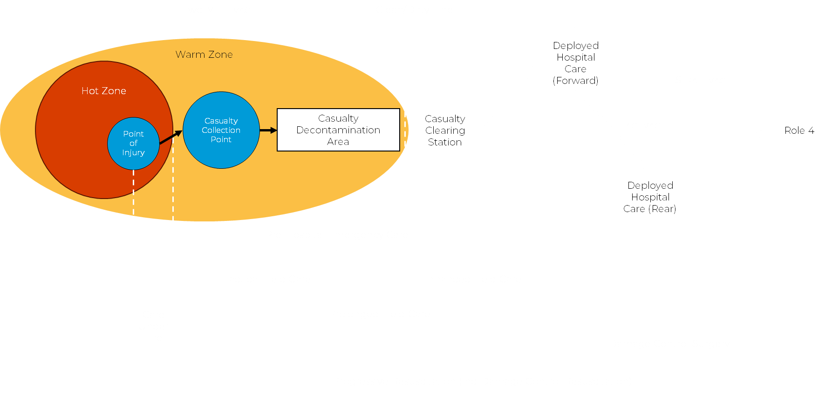
The Operational Patient Care Pathway (OPCP)
This process describes how patients should flow through increasing levels of healthcare from the point of injury
In a deployed operation, we expect a web of pathways between multiple hospitals, with dozens of points of injury
5
BAE Systems proprietary. Copyright ©2024 BAE Systems. All rights reserved. BAE Systems is a registered trademark of BAE Systems plc.

Slide 5
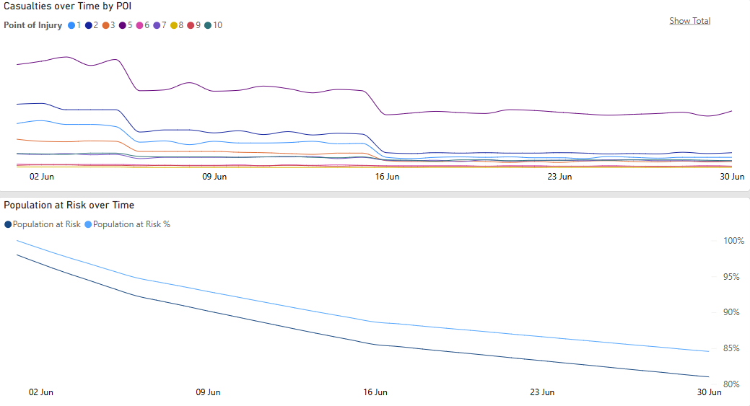

Shaping Assumptions
1 Casualty Estimation
1 Injury Types & Severities
1 Treatment Durations
1 Queue Consequences
› Not aiming to recalculate casualty estimates – doing so would require ballistic patterns and detailed threat analysis
› Casualty estimates taken from policy documents and previous studies – X% of deployed personnel per day, of which Y% are T1/T2/T3
INDICATIVE
BAE Systems proprietary. Copyright ©2024 BAE Systems. All rights reserved. BAE Systems is a registered trademark of BAE Systems plc.

Slide 6
Shaping Assumptions
* Numbers for indicative purposes only *
1 Casualty Estimation
1 Injury Types & Severities
1 Treatment Durations
1 Queue Consequences
› More detail was needed on where injuries might occur, how serious they might be
› Data from past operations gave us assumptions on injuries
› Also gave indicative durations for different treatments – resuscitation, surgeries, intensive care etc
› What happens if a patient in need of care can’t receive it due to a shortage of beds/ personnel/ equipment?
› Experts in clinical & emergency medicine consulted to judge and improve assumptions
INDICATIVE
BAE Systems proprietary. Copyright ©2024 BAE Systems. All rights reserved. BAE Systems is a registered trademark of BAE Systems plc.

Slide 7

The CHIRON Model
BAE Systems proprietary. Copyright ©2024 BAE Systems. All rights reserved. BAE Systems is a registered trademark of BAE Systems plc.

Slide 8
Simulating Deployed Medical Care
To answer the task, Techmodal built a Python discrete-event simulation model – CHIRON (/ˈkaɪɹən/ – Combat Healthcare Intelligence and Response in an Operational Network) – simulating the OPCP network in an operational setting
Casualties Generated
Injuries Assigned
(Triage category, region, severity)
Treatment Requirements Assigned
Enter OPCP at Point of Injury
Flow through Medical Facilities
Simulate treatment at each node & transport between
If no capacity, patients join queue – may deteriorate/die if waiting too long
All treatments received, patients go back to unit or evacuate
Patients evacuate
Patients die
Patients return to unit
DOCUMENT TITLE
BAE Systems proprietary. Copyright ©2024 BAE Systems. All rights reserved. BAE Systems is a registered trademark of BAE Systems plc.

Slide 9
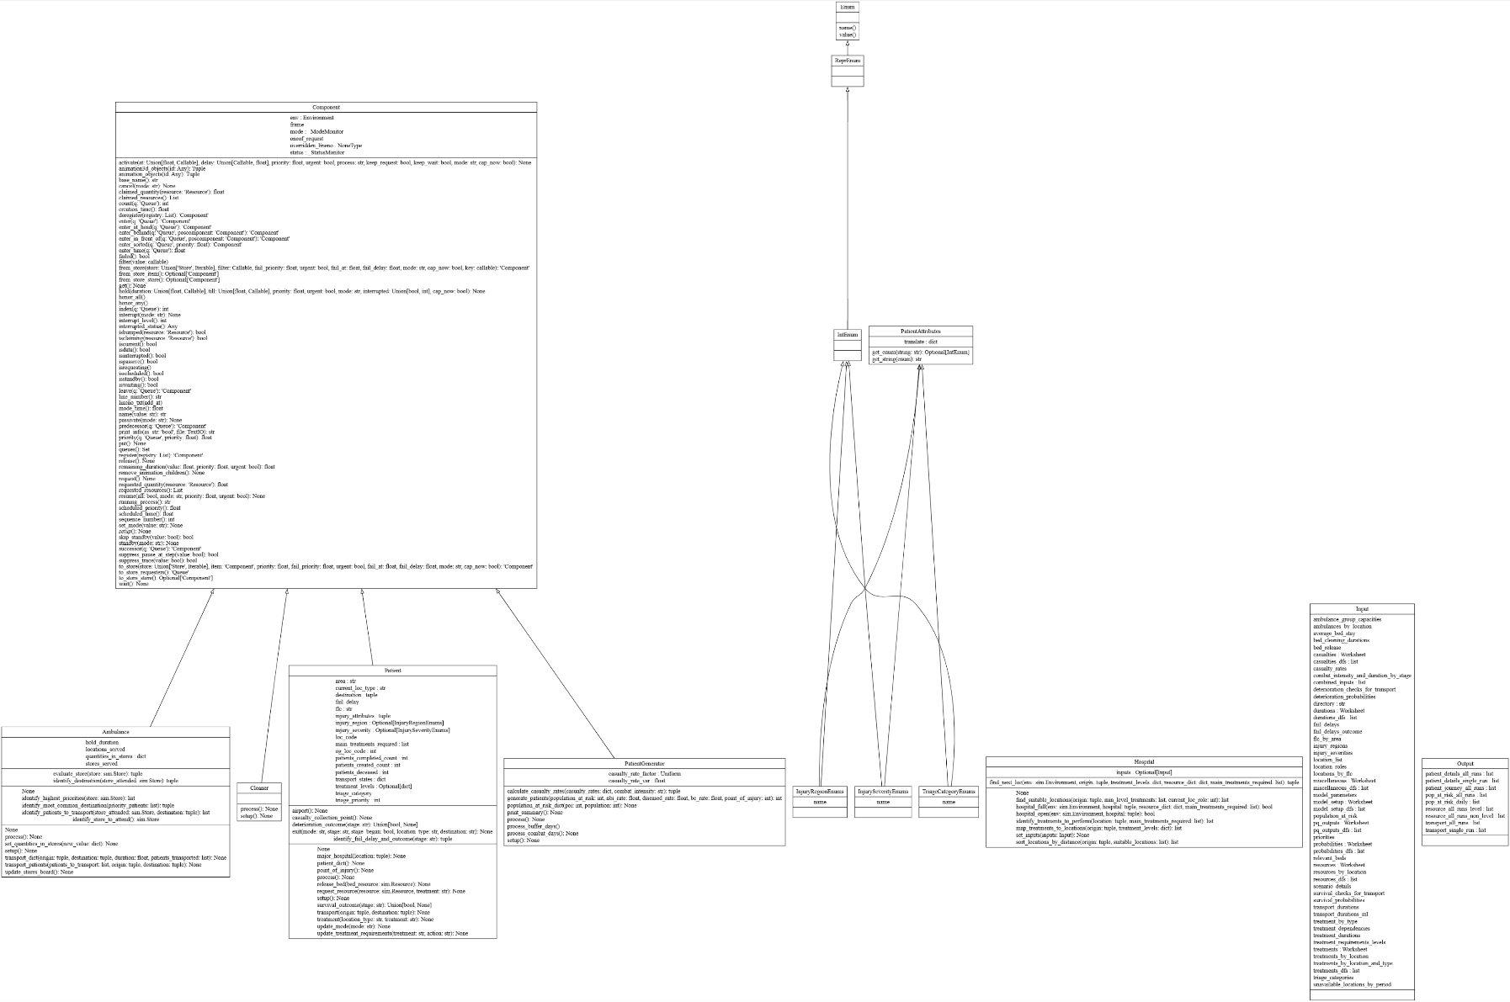
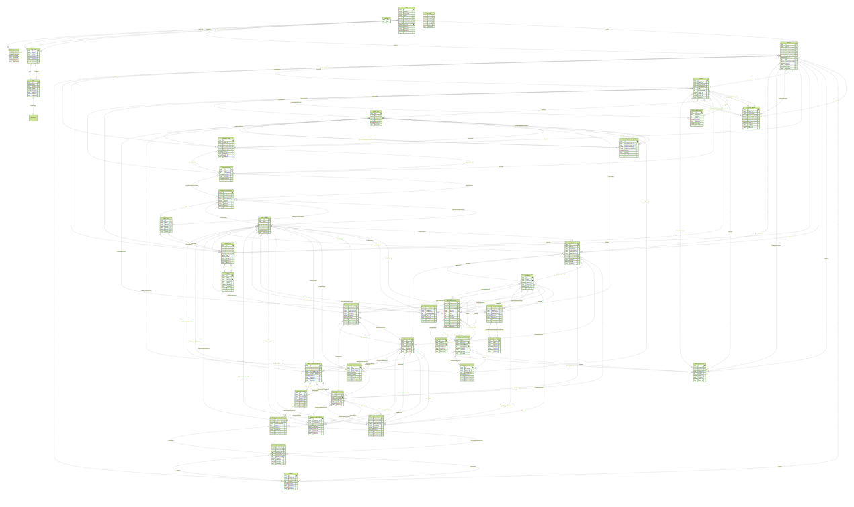
Technical Build
Built in Python using Salabim, a discrete event simulation package
Complicated data model
Simplicity of class structure
Modular design with flexible functions – could easily be adapted to model distribution of aid, for example
54321

Slide 10
* Numbers for indicative purposes only *
Modelling a Combat Scenario
10,000 personnel spread across 5 locations – e.g. 3x Combat BCTs, 1x Avn BCT, Joint Operating Area
2x Med Regts in support of Combat BCTs (Role 1 care)
2x Fwd Hospitals (Role 2)
2x Rear Hospitals (Role 3)
Simulating a Divisional assault for 15 days, with 2x Combat BCTs in Medium-High Intensity combat
Combat BCT (2000 pers)
Combat BCT (2500 pers)
Combat BCT (1000 pers)
Med Regt
Med Regt
INDICATIVE
Fwd Hosp
Avn BCT
(500 pers)
Fwd Hosp
Rear Hosp
JOA
(4000 pers)
Rear Hosp

Slide 11
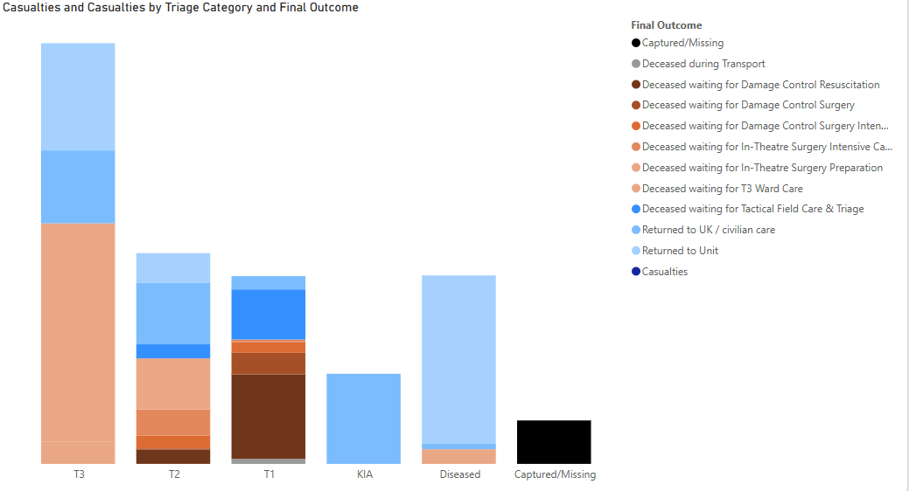
* Numbers & graphs for indicative purposes only *
Modelling a Combat Scenario
XXX
XX%
XX%
XXX
XXX
XXX
casualties
T1 patients dying before DCS
reduction in active Combat BCT personnel by day 15
INDICATIVE
Patients evacuated to UK-based care
Simultaneous surgeries required
Simultaneous patients requiring intensive care

Slide 12
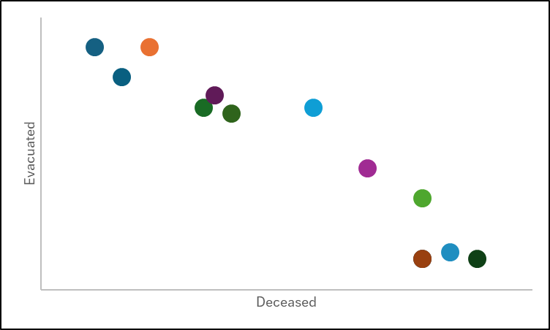
Modelling a Combat Scenario
Capacity, in isolation, is not necessarily a ‘silver bullet’; other factors, such as distance to treatment facilities, also impact survivability. Additionally, changing in-theatre processes/upskilling can improve outcomes.
Variations of 3 options considered to improve performance
Aim to increase survivability on the battlefield to maximise patient evacuation to more definitive care
Evidence for change in approach in extreme warfighting circumstances
XX% increase in survivability

Slide 13
6
Impact to DMS
Assess the efficacy of operational planning
Quantify the impacts of capability shortfalls or enhancement
Support investment decisions with clear evidence
Improve operational effectiveness of fighting units
Improve UK forces’ survivability
IN THEIR WORDS
“This has given us, without hyperbole, world-leading capability”
– Cdr Dan Henning, SO1 Med Cap Strat

Slide 14

Future Development
Currently incorporating equipment & personnel requirement calculation
Modular design means CHIRON could easily be adapted to simulate:
Multi-national operations
Civilian medical care
Humanitarian Aid / Disaster Relief
BAE Systems proprietary. Copyright ©2024 BAE Systems. All rights reserved. BAE Systems is a registered trademark of BAE Systems plc.

Slide 15


